Slide 1

Ellucian / Colleague Student Planning Instructions for Advisors
The PACE Office • advising@ferrum.edu

Slide 2
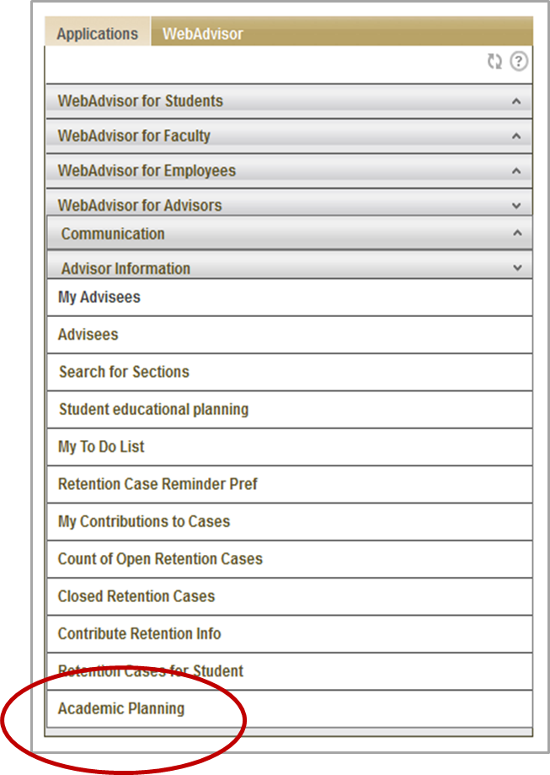
Log into the portal and go to the Web Advisor Menu at the bottom right.
Click on Faculty Information or Advisor Information , then Academic Planning (the last menu choice).

Slide 3
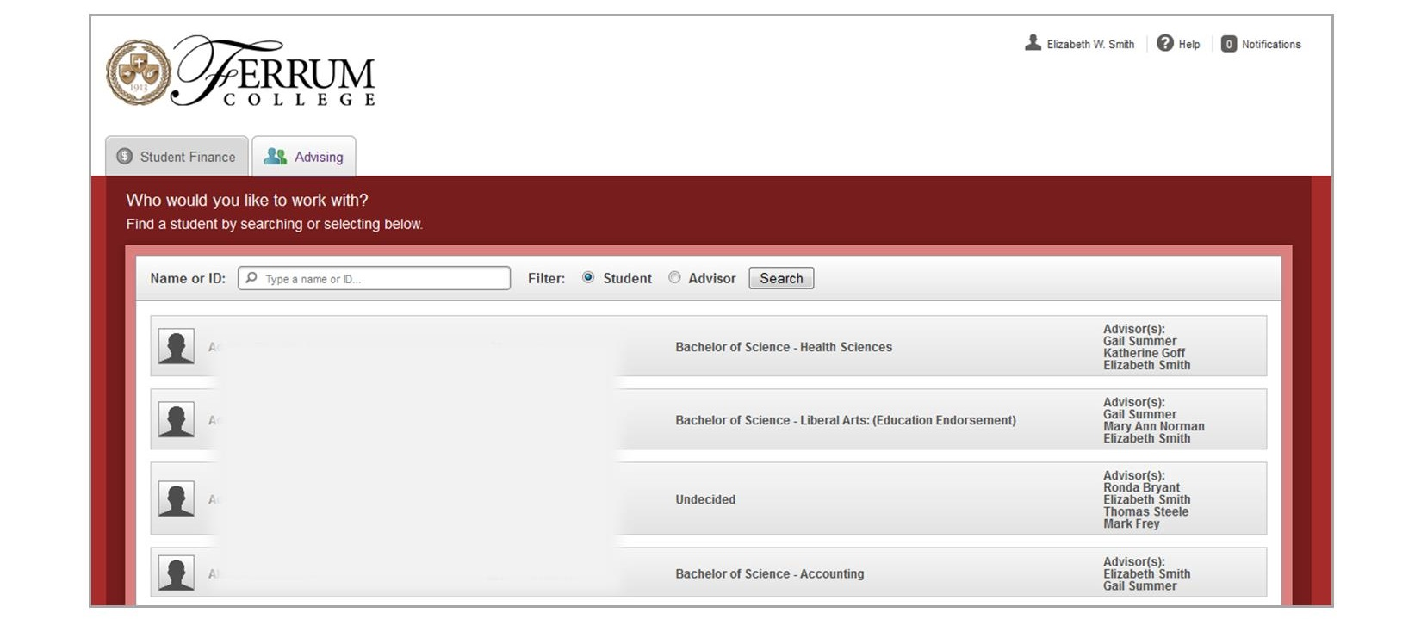
Search by name or ID number for the advisee you’re working with, or choose a student from the list of your advisees that will appear below the search box.

Slide 4
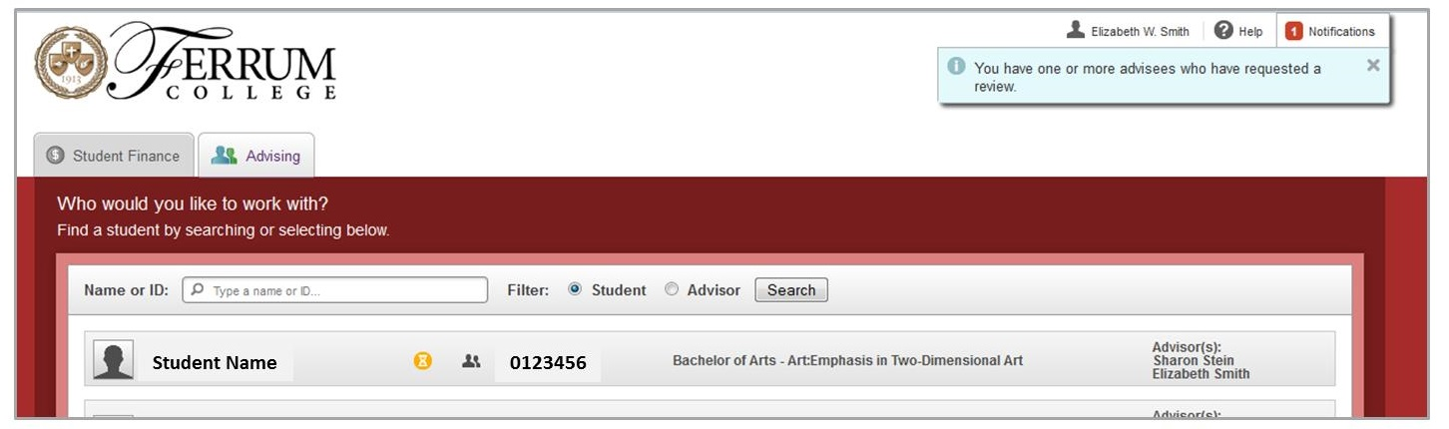
I. Advisor Approval of Plans and Schedules
②
①
①Students who have plans ready for your review will be at the top of your list, and will be marked with the yellow hourglass icon  .
②You will also see a notification at the top of the screen if you have advisees who have requested a review.
The system does not send e-mail notifications of schedules/plans awaiting approval; encourage students to e-mail you when they have requested a review. Remember, advisor approval is required before any student can register.

Slide 5
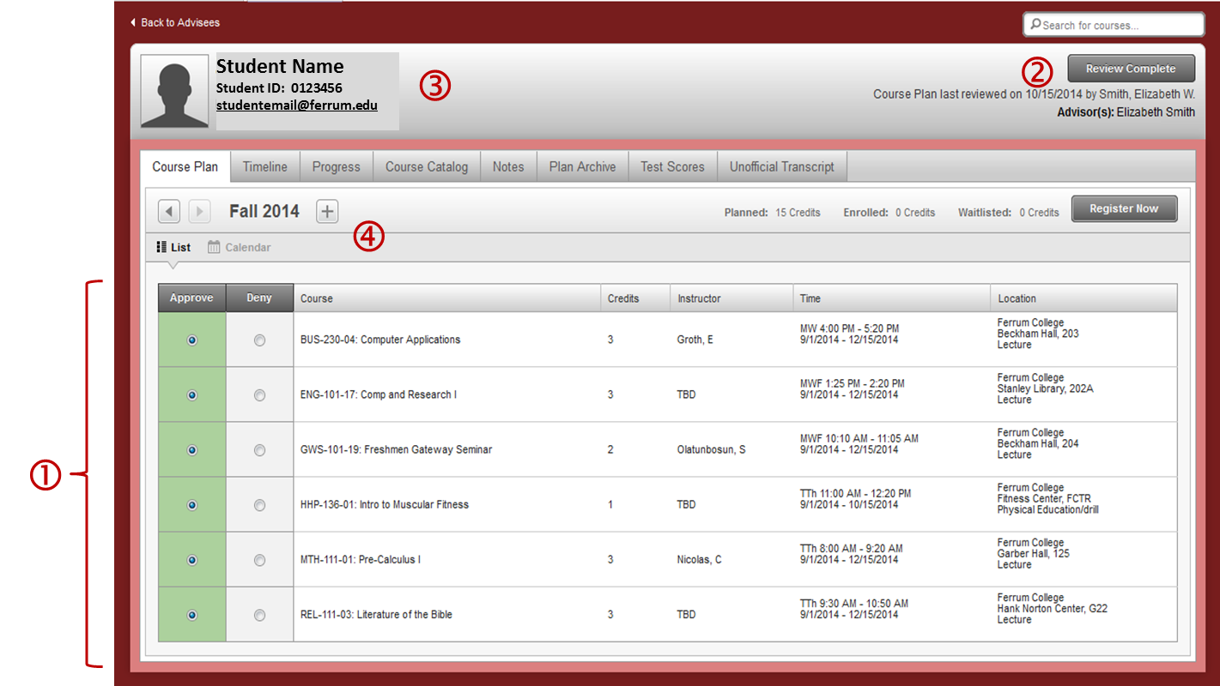
① The first screen you will see for each advisee is the course plan for the current semester (List View). You can approve or deny each course a student has chosen using the radio buttons, or click at the top of the column to approve all.

Slide 6
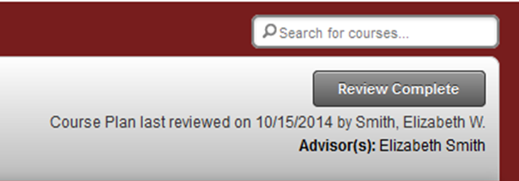
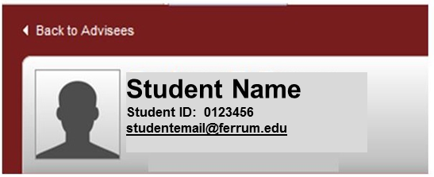
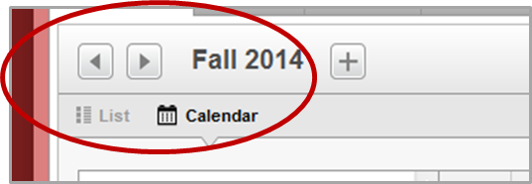
② When you have finished, click on the Review Complete button at the top right of the screen.
③ The student’s name, ID number, and
e-mail address (which is a link) will always appear at the top left of your screen.
④ You can use the arrow buttons just below the student’s information (to the left of the term) to scroll through planned semesters and even approve planned courses in future semesters. If you click on Calendar, it will take you to the calendar view of the student’s schedule.

Slide 7
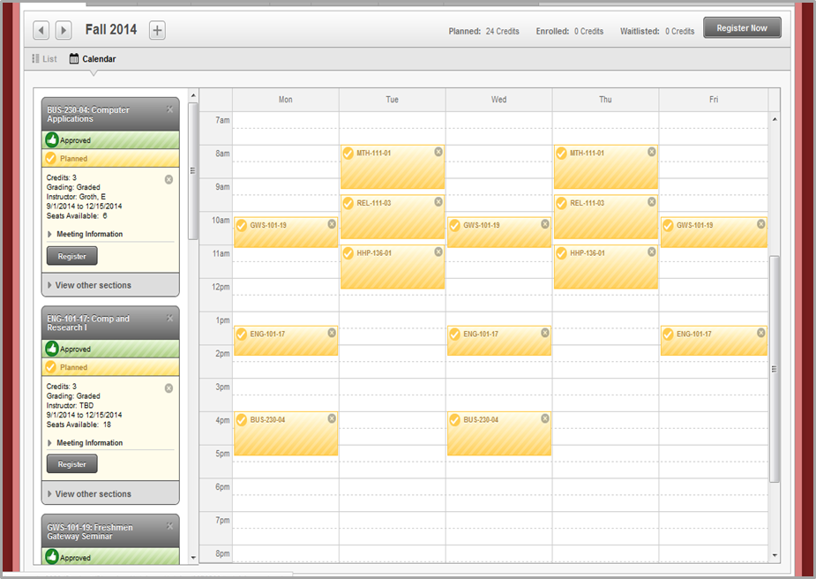
Calendar View
Students have a link to download this to a calendar on their phone, tablet and/or computer.
The courses here are yellow because they are only planned; if the student were registered for them, they would be green.

Slide 8
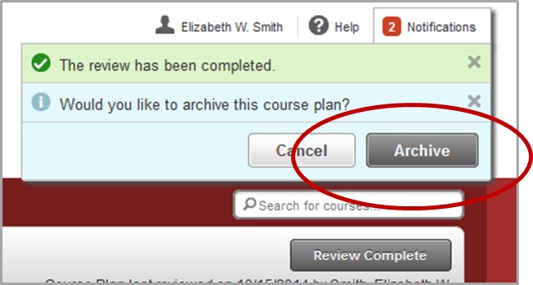
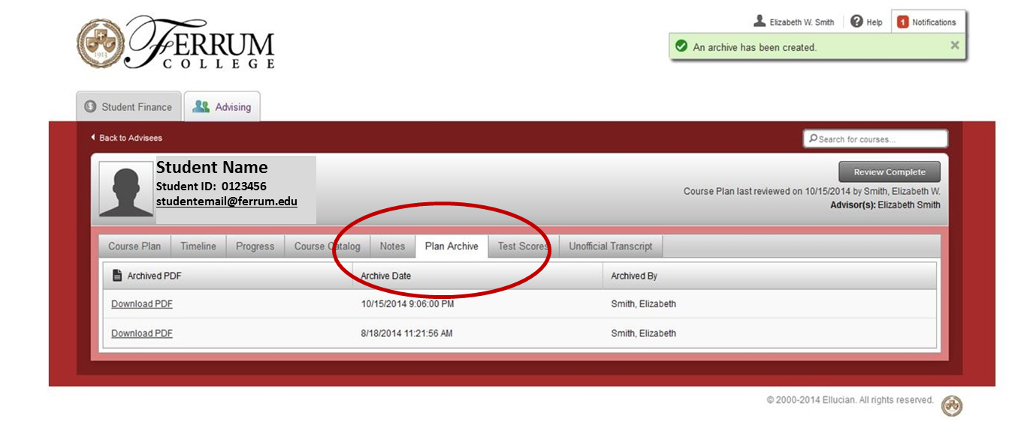
When you click the Review Complete button, you will get two notification messages at the top right of the screen under your name. Click the Archive button to save the student’s current course plan.
Under the Plan Archive tab you can download a .pdf file of any archived plan.

Slide 9
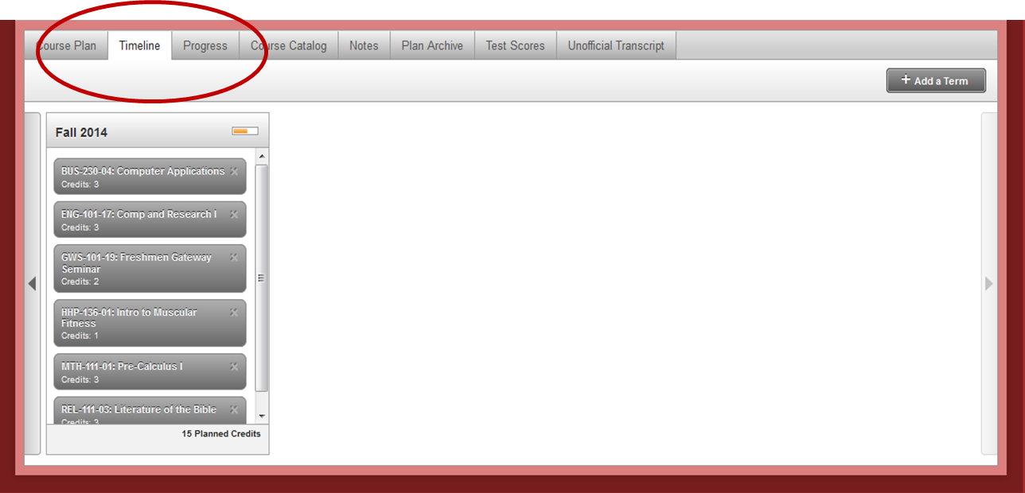
Planning Tools:
Progress/Program Evaluation and Sample 8-Semester Plans
Under the Timeline tab, you can view the student’s entire 8-Semester Plan (or at this point, lack thereof).

Slide 10
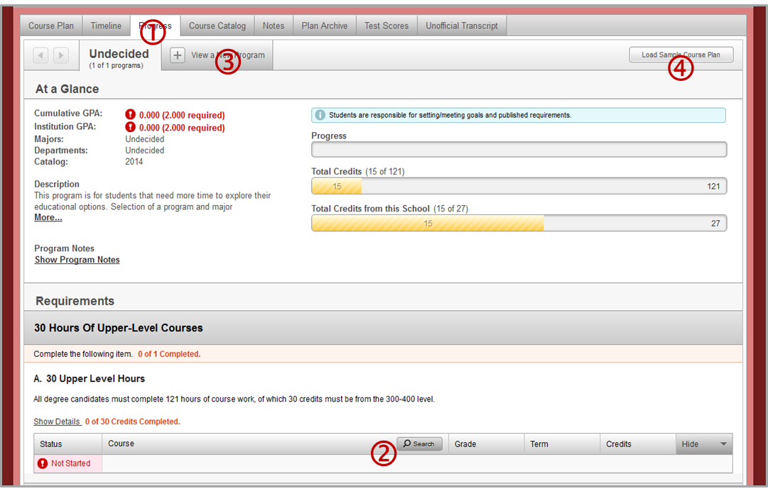
① The Progress tab will display the student’s Program Evaluation. This screen includes the same information as the Program Evaluation in Web Advisor. This is the first view that students will see when they enter Student Planning.
② Search buttons give you the ability to search for appropriate courses from here.

Slide 11
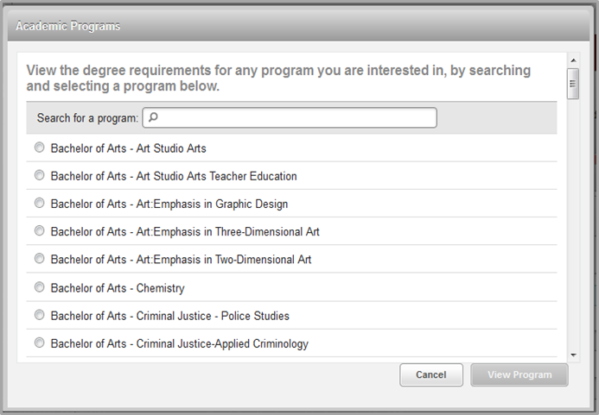
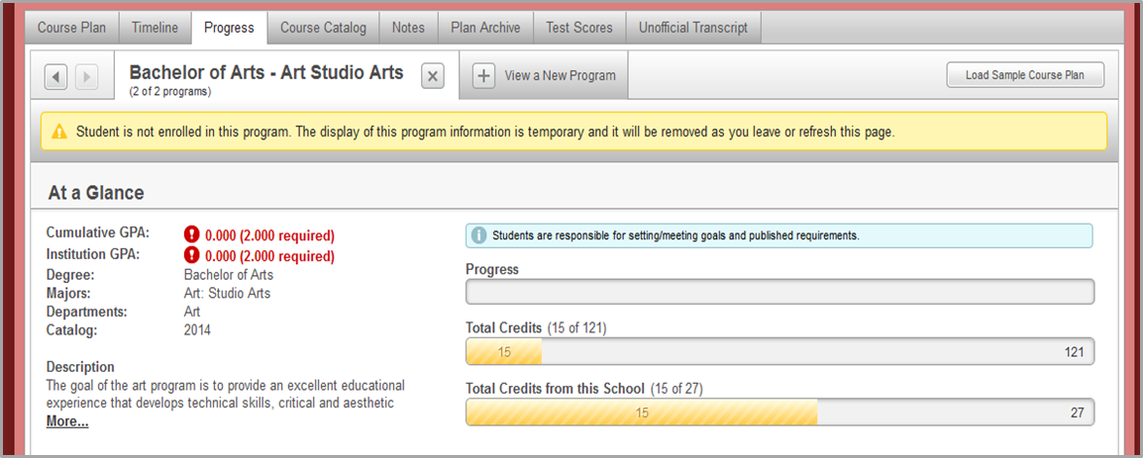
③ Advisors and students can play “What if …” (look at the student’s progress toward different potential majors) by clicking on the the View a New Program tab and choosing a program from the list in the pop-up box.

Slide 12
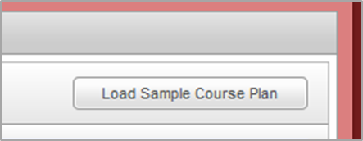
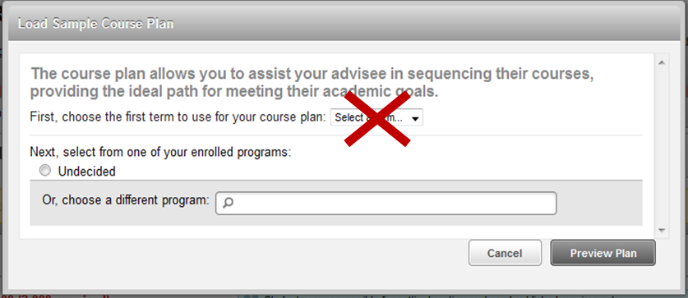
④ Advisors and students can view 8-Semester Plans by clicking on the Load Sample Course Plans button at the top right of the screen. These plans can also be loaded onto the student’s Timeline.
In the dialogue box, either skip selecting a term or choose the current term. Use the radio button to choose the plan for the program the student is
currently in, or search for a different one. You only need to type in a few letters of a program name to search.

Slide 13
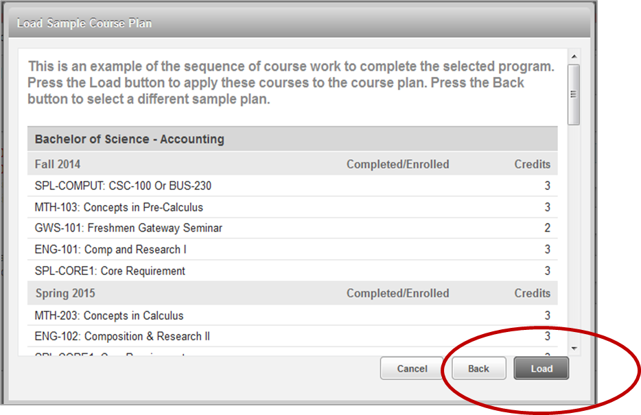
The sample plan will come up in another pop-up box. You can scroll through it to review planned courses. This is where Program Coordinators should review the plans as entered for accuracy. The original plans will continue to be posted at www.ferrum.edu/academics/coursework.
Clicking the Load button will place these courses onto the student’s plan, which can then be viewed under Timeline. Be careful not to click Load if you are just reviewing a sample plan.

Slide 14
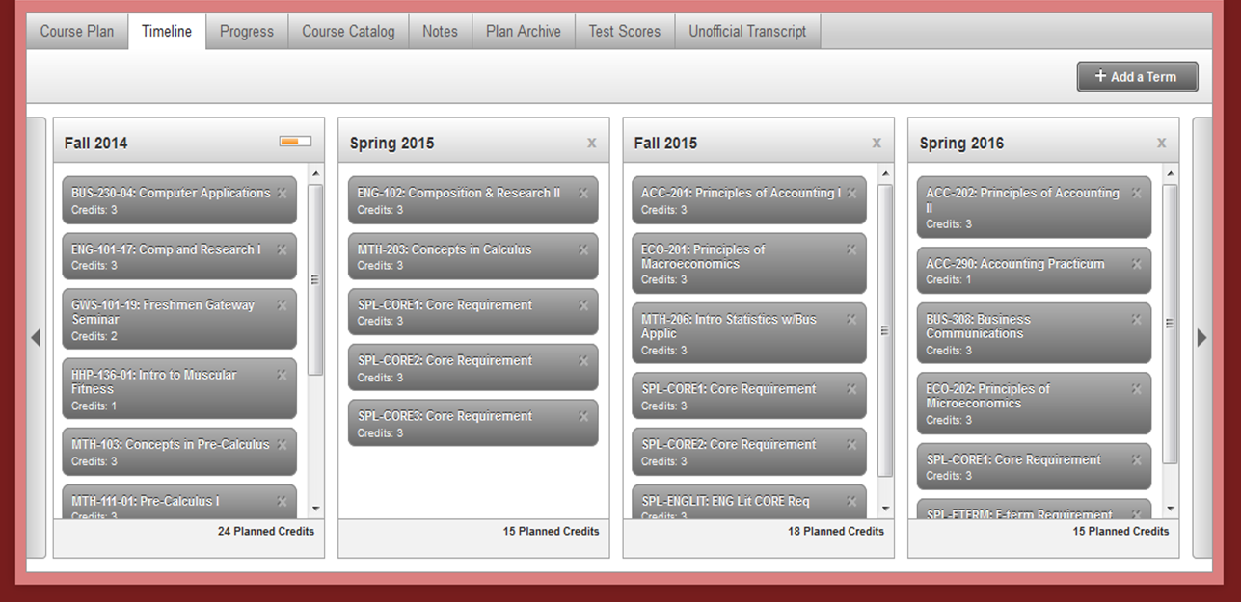
Here is the same timeline with the sample plan loaded.
Courses or entire semesters can be deleted by clicking on the .

Slide 15
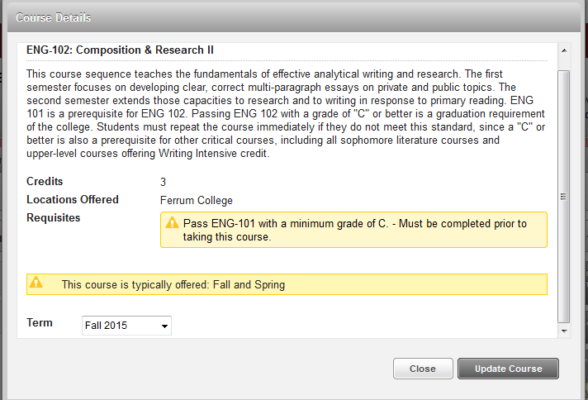
Courses can be moved to another semester by clicking on the course name to bring up another dialogue box. Choose the new term from the drop-down menu.
Note that in this view, a yellow warning appears if the student has not yet taken or planned a pre-requisite. These warnings are also shown on the student’s Timeline.
!

Slide 16

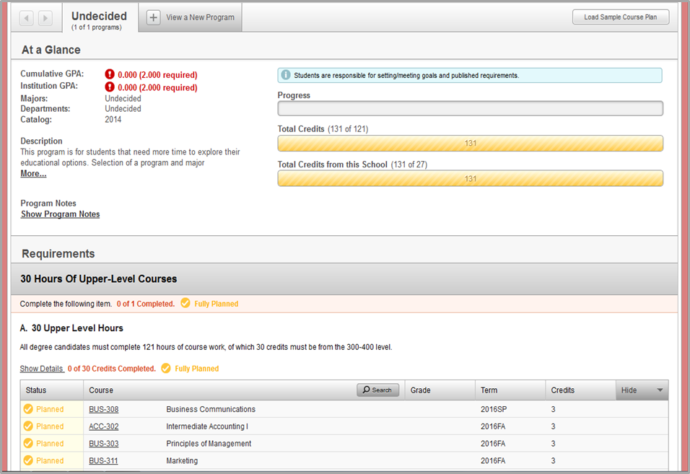
Back on the Progress screen, note that required courses now show up with yellow icons, since they’ve been planned; the progress bar at the top will be yellow, too. Courses that student has completed or registered for will be indicated in green.
When a student has met a requirement, courses under it will be marked as fulfilled.

Slide 17
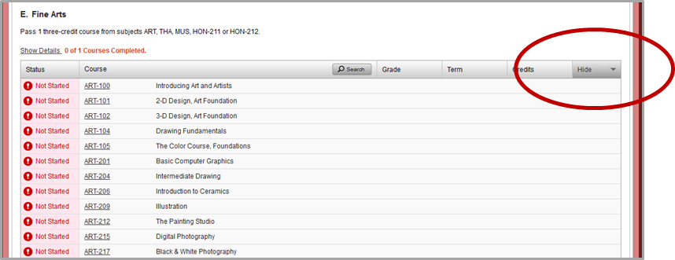
When you click on a course name or the search button to add a course to a student’s plan, it will take you to the Course Catalog (see the next section of these instructions). Click on the Progress tab to return to the program evaluation.
Since some of the requirements on this page have a long list of courses that could fulfill them, you may find the Hide button helpful.

Slide 18
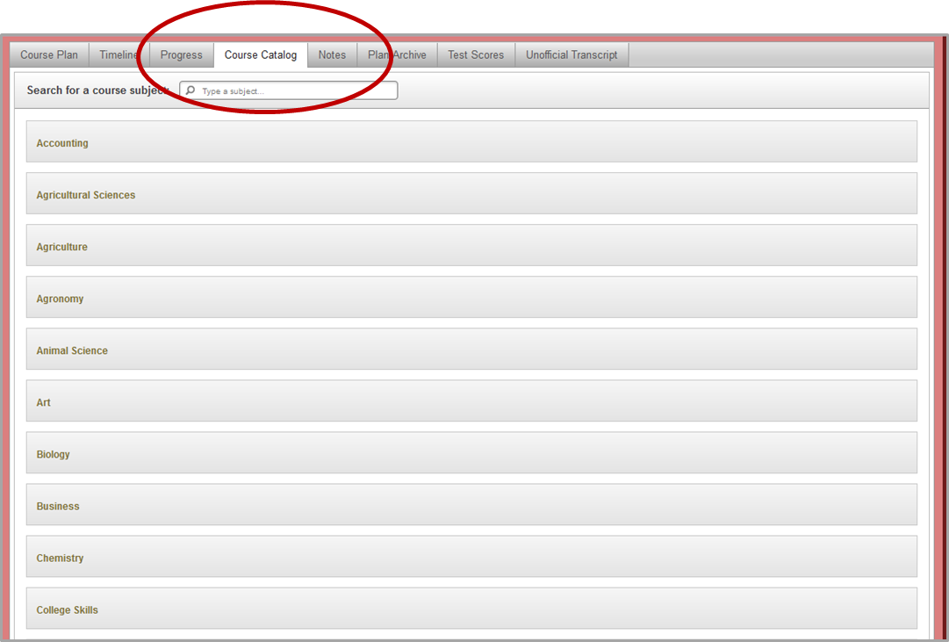
III. Course Catalog, Scheduling and Registration
Course descriptions and available sections, searchable by subject, are under the Course Catalog tab.

Slide 19
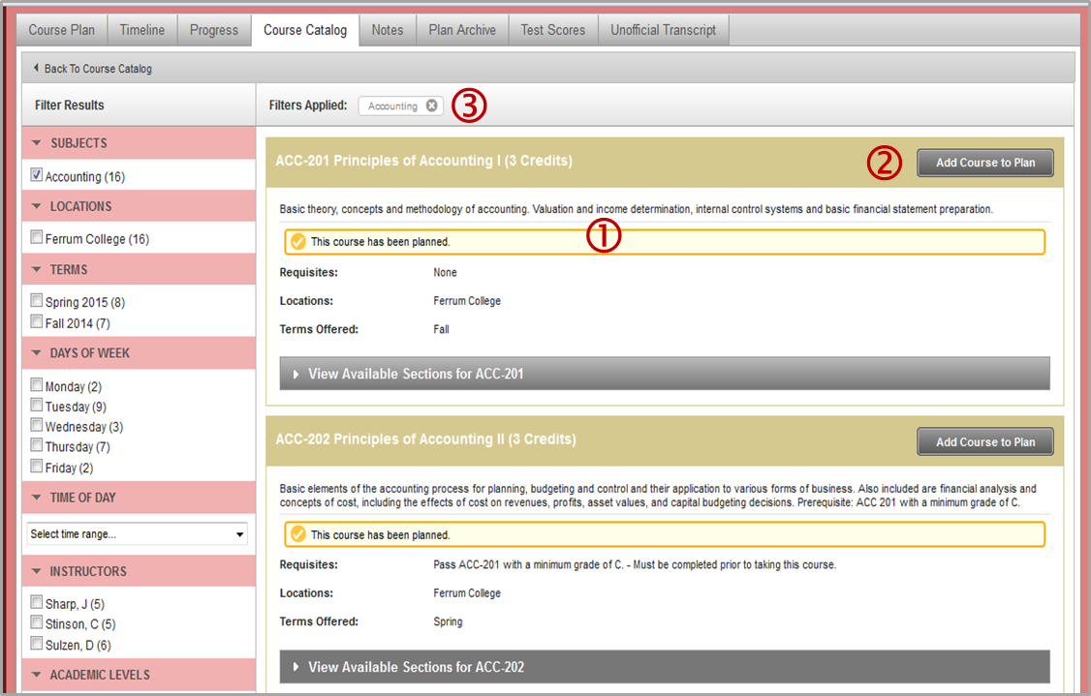
① When you choose a subject, the descriptions for each course in the catalog will come up.
② The Add Course to Plan button can be used to place a course on a student’s plan from here.
③ If you want to view all courses in all subjects, you can delete the applied filter by clicking on the .

Slide 20
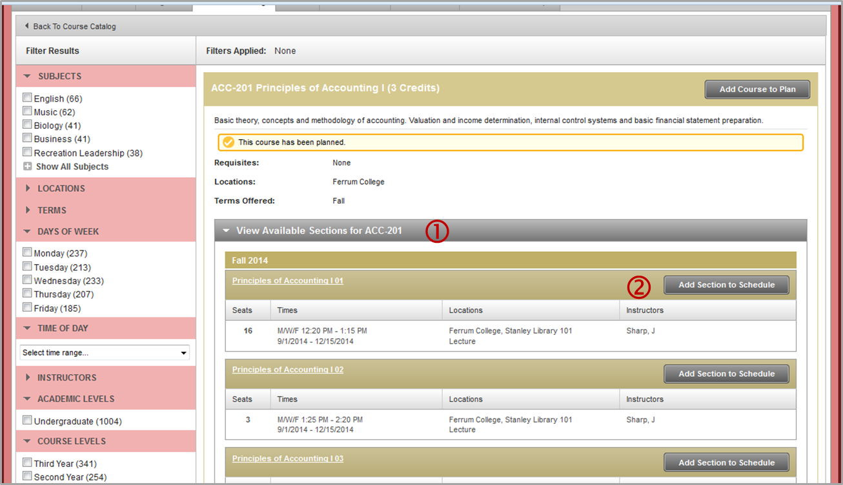
① For courses that are being offered in the current term, there will be an option to View Available Sections. Clicking on it will bring up scheduled course sections.
② The Add Section to Schedule button will add this course section to the student’s plan.

Slide 21
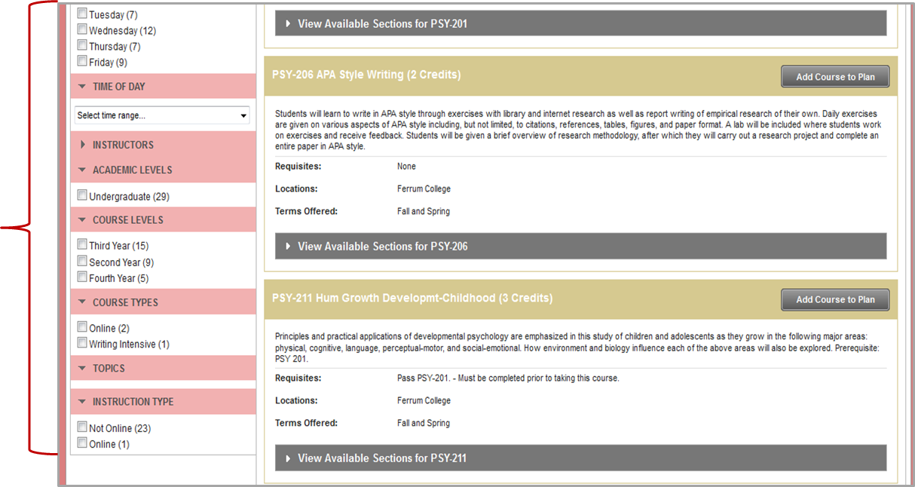
On the left side of the screen, courses can be filtered by days and times, instructors, and course types including on-line, writing intensive, and E-Term.

Slide 22
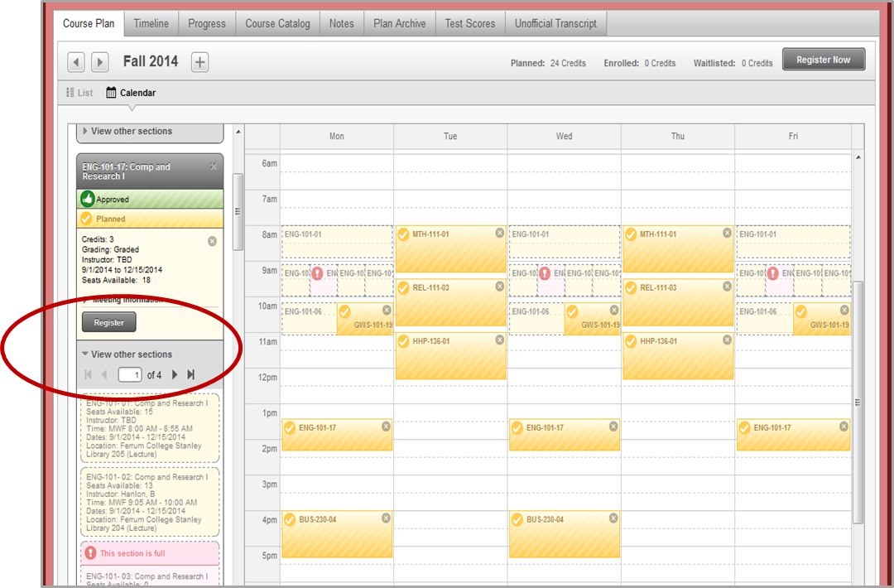
Sections being offered in the current term for planned courses can also be accessed in Calendar View; just click View Other Sections under each course on the left side of the screen. All sections will show in a lighter color with dotted outlines on the student’s schedule view. This makes time conflicts easy to spot.

Slide 23
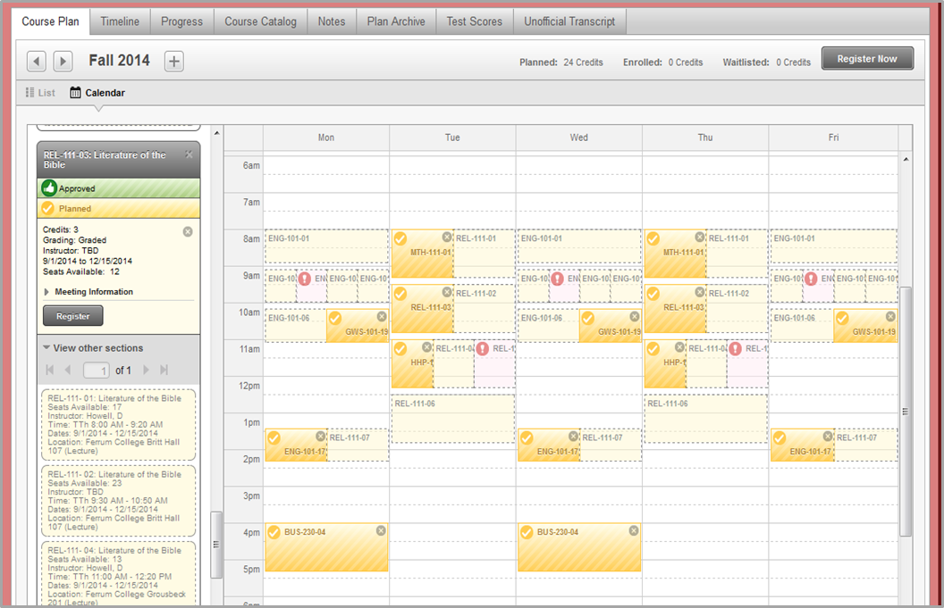
Sections can be viewed for multiple courses at once. Closed (full) sections will be in red with an icon . Clicking on a section here will add it to the plan. Yellow pre-requisite warnings will also show on the course list on this screen.
!
!

Slide 24
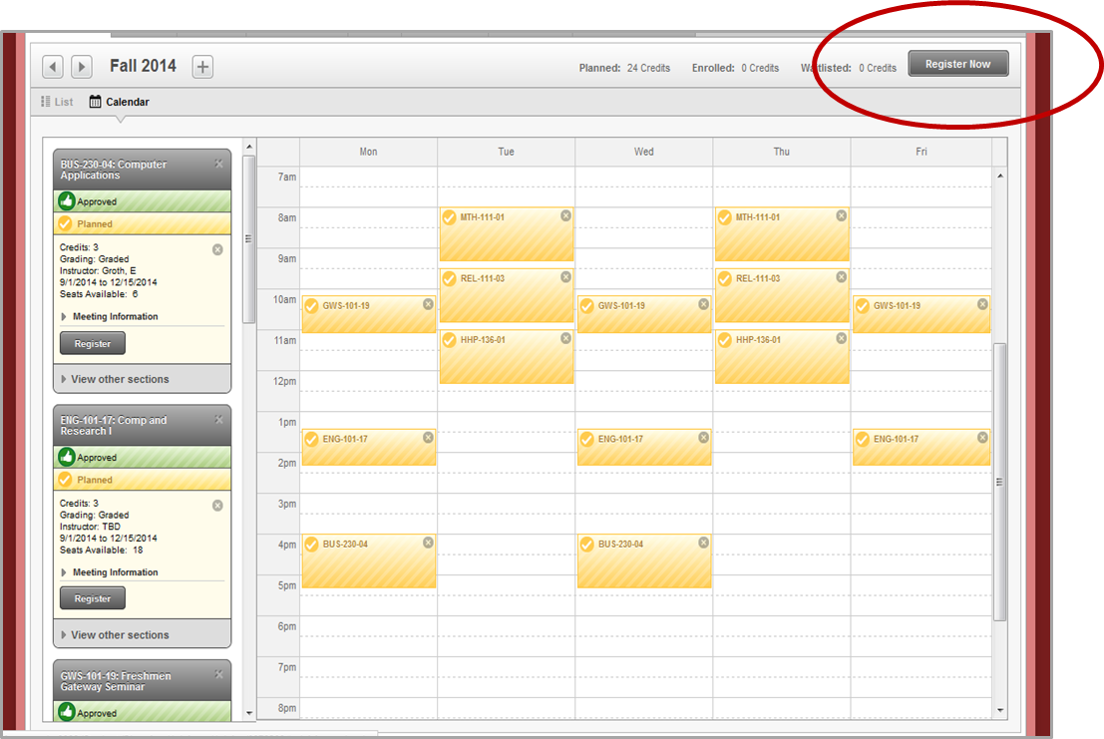
If you have approved the student’s schedule, either you or the student can use the Register Now button to complete the registration process. It will not be available until the registration window opens for the student’s class.

Slide 25
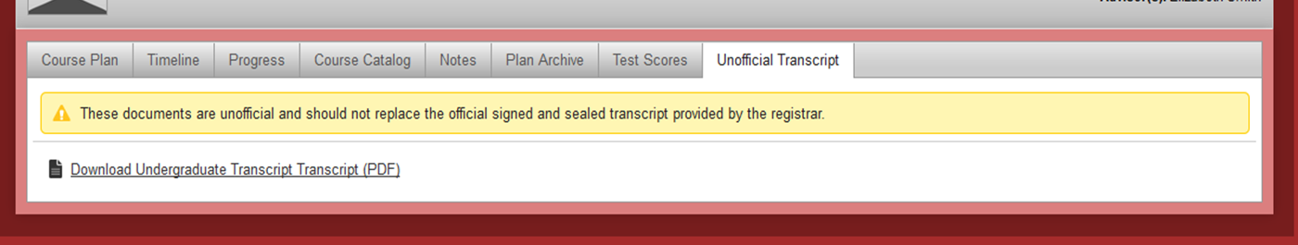
III. Unofficial Transcripts, Notes and Test Scores
By clicking on the Unofficial Transcript tab, you can download a .pdf version of the student’s unofficial transcript. Students will also have the ability to do this themselves.
There is a Notes function in Student Planning that was developed by Ellucian primarily as a means for advisors and students to communicate with each other. However, using the e-mail link to send a quick message to your advisee may be more effective than using the Notes tool. Keep in mind that anything posted here can be seen by the student and all assigned advisors.

Slide 26
The Test Scores tab will let you see a student’s SAT and or ACT scores. You may also see a Math Placement Test score for some students. These numbers are not the students’ actual scores; they were categories we entered behind-the-scenes to make the math pre-requisites work.
Questions?
E-mail Betsy Smith (bsmith@ferrum.edu) or Donna Winge (dwinge@ferrum.edu), or call the PACE Office at 540-365-4270.

Slide 27
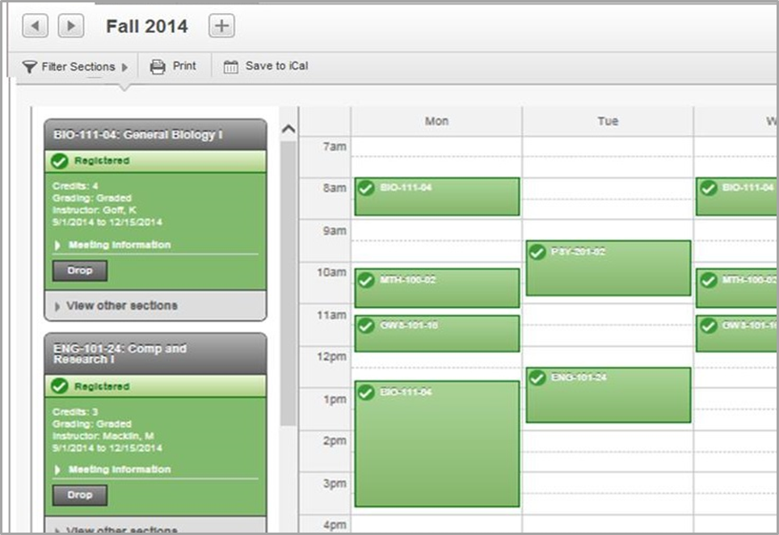
IV. Dropping Courses After Registration
Drop buttons are located in Calendar View, under each course on the left side of the screen.

